Slide 1


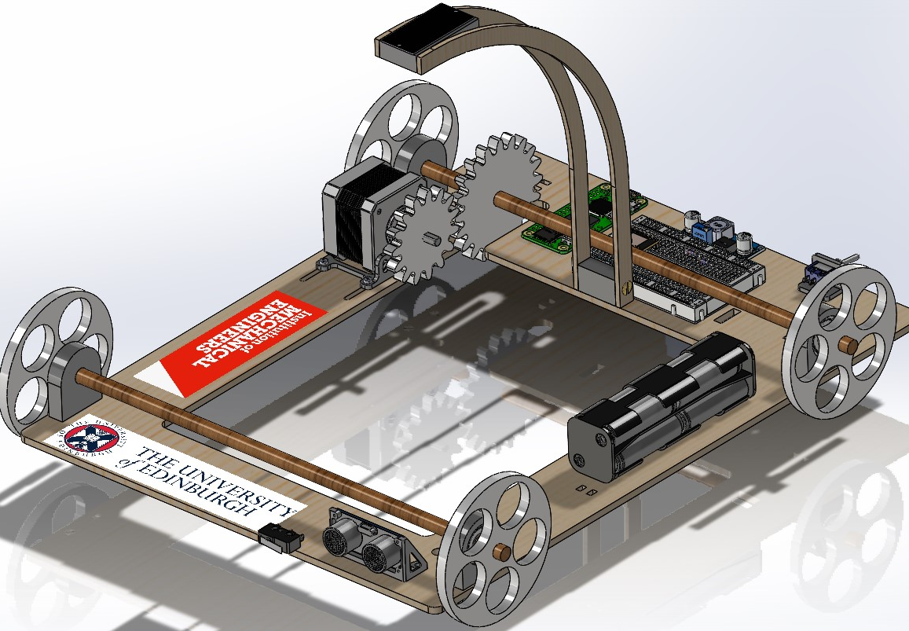
IMechE Design Challenge 2024
Gursager Singh
Shehan Medagedara
Harry Wang

Slide 2
Challenge Overview
Advanced Category:
Usage of Computer Vision
Using motor and gear reduction for accurate movement
Notes:
Went with Advanced category -> gave us the opportunity to use computer vision to detect the target, as well as use a motor in conjunction with gear reduction system to ensure accurate movement

Slide 3
Vehicle Design

Slide 4
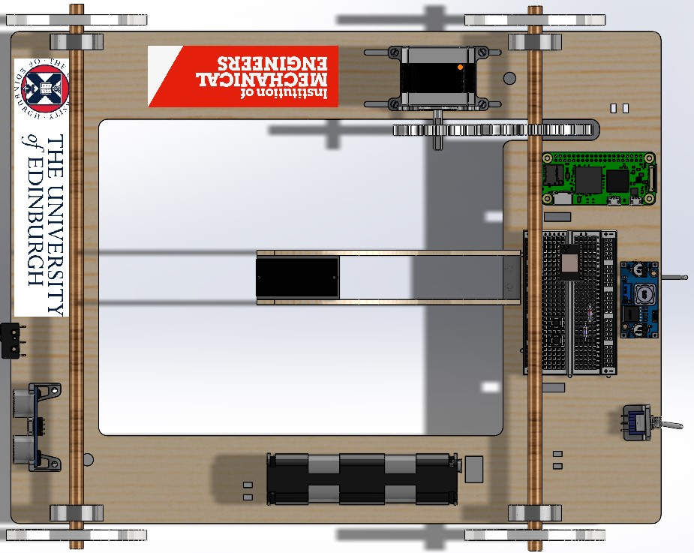
Design Overview
NEMA 17 Stepper Motor
Wheel
Axle Holder + Ball bearings
Axle
Motor Gear
Raspberry Pi Zero 2 W
Output Gear
Breadboard
Limit Switch
TMC2208 V3 Stepper Driver
Webcam
Buck Converter
Ultrasonic Sensor (HC-SR04)
Battery Pack
On/Off Switch

Slide 5
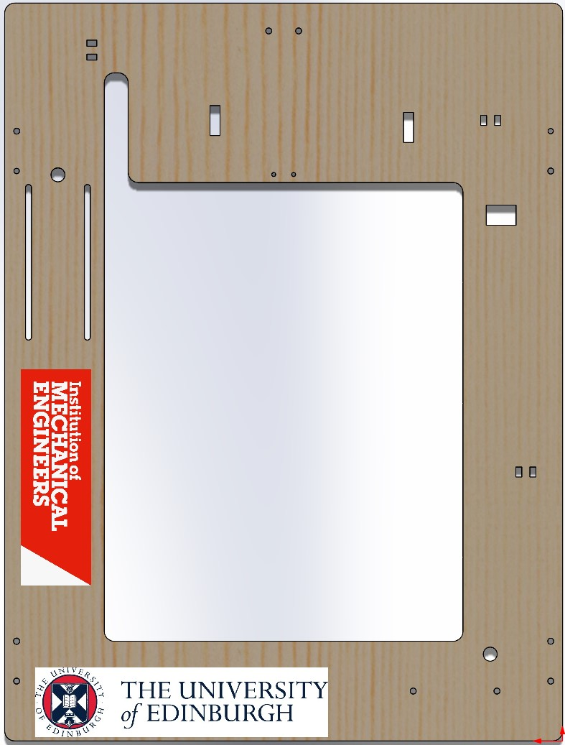
Chassis
0.4mm MDF
Target detection gap
Drill holes to securing components
Cable routing channels
Notes:
0.4mm MDF: perfect thickness and material to withstand weight and forces while staying relatively cheap
Large gap in centre for optimal target detection, system works best when target is directly underneath camera
Cable routing: ensures that the system looks neat, keeps cables out of the way. Dangling cables = hazard

Slide 6
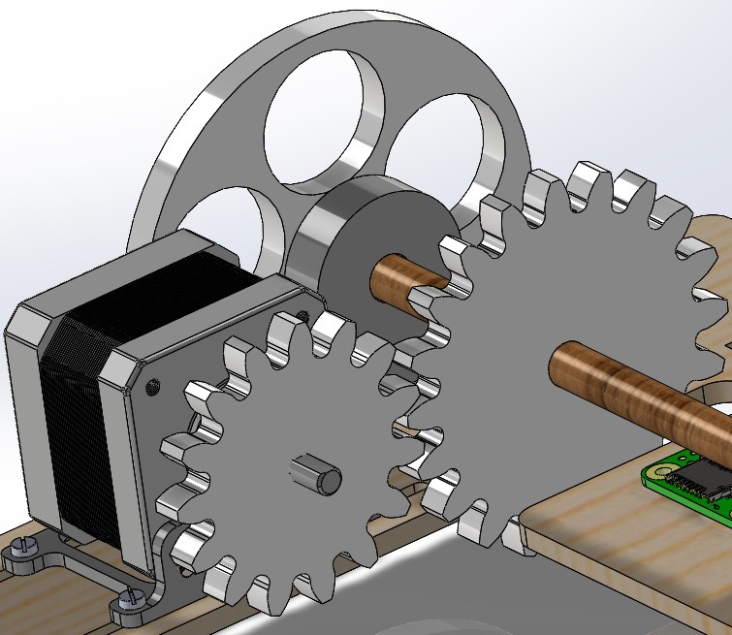
Powertrain
NEMA 17 Motor
Reduction gears at 4:3 reduction ratio
Angular velocity of wheel = 0.75 of that of motor
Allows stable movement
Notes:
The NEMA 17 motor was chosen to deliver the power required
Motor needed to run at a certain angular velocity or else it will stutter. Reduction ratio allows the motor to run at higher speed while wheel travels slower and more accurately

Slide 7
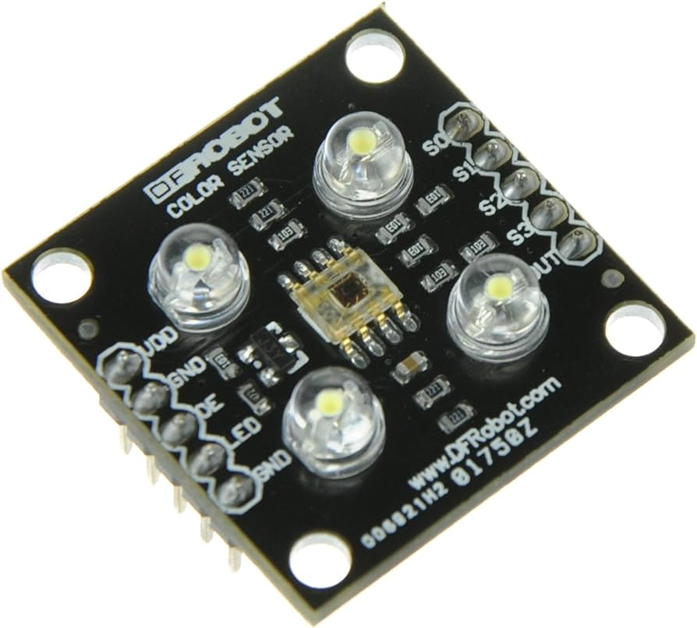
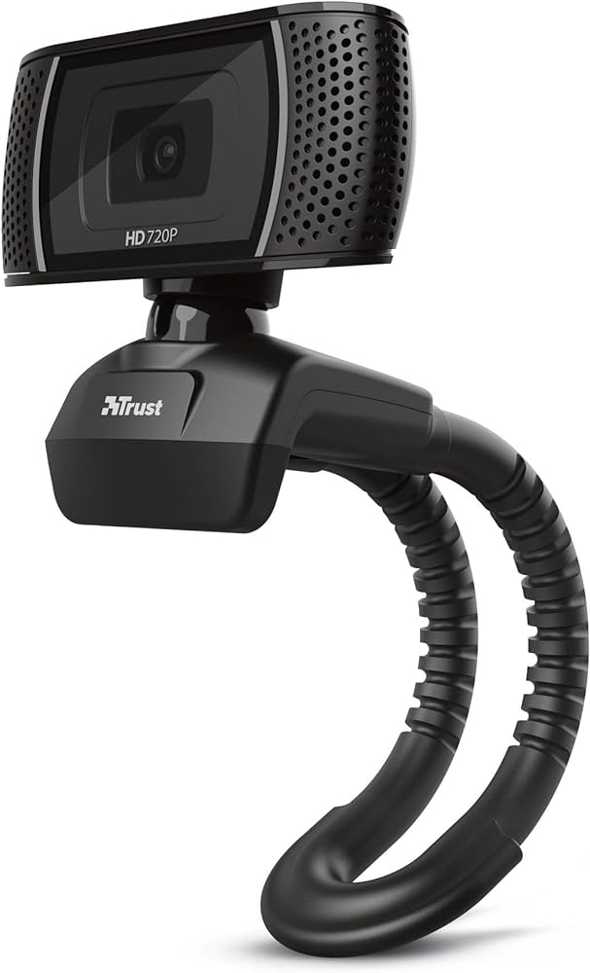
Target Detection Method
Initial idea: use a colour sensor with an Arduino
Problem: boundary between different colours could not be identified precisely
Solution: computer vision
= using an algorithm to detect circles from camera input

Slide 8
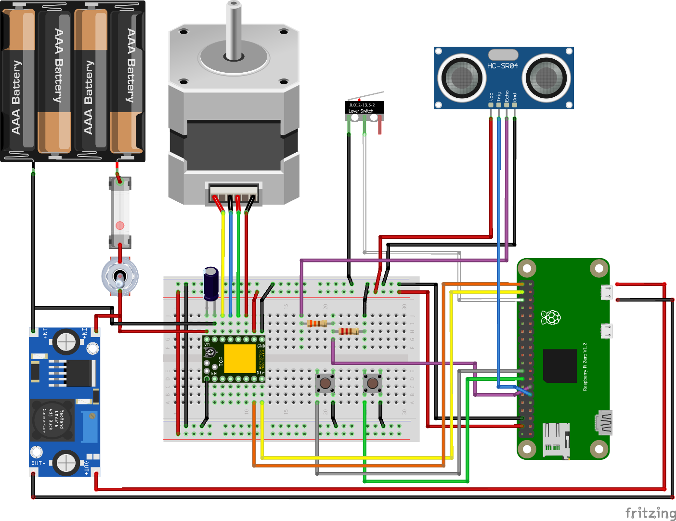





Circuit Diagram
Safety
Power Switch
Fuse
Insulation on 12 V supply
Functionality
Start button
Reset button
R2
R1
Camera In
12 V IN
5 V OUT
RESET Button
START Button
Notes:
This circuit diagram outlines the essential components and connections for the device. Safety features include a power switch and a fuse to protect against electrical faults. A start and reset button can be used for easier control of the device.

Slide 9
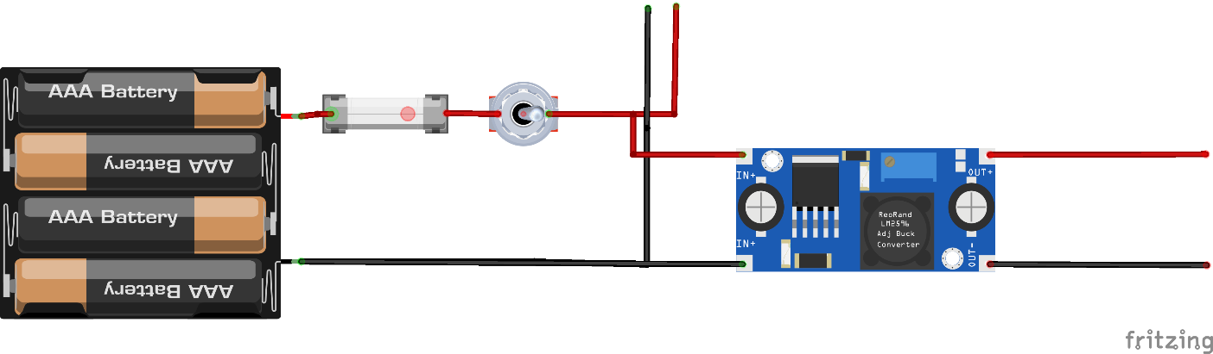





Power Distribution
Battery supply voltage:
12 V
Operating voltages:
Stepper motor – 12 V
Raspberry Pi – 5 V
Notes:
The whole system runs on a 12 V battery pack which has to power the Raspberry Pi and the stepper motor, both with different operating voltages. So, the supply voltage is split in parallel to the motor driver and to the buck converter. The buck converter steps down the battery voltage to 5 V which then supplies it to the Pi.
DO NOT READ:
- buck converter is a type of switch-mode power supply (SMPS) that changes voltage through duty cycle control.
- buck converter stabilises voltage - protect the Raspberry Pi against voltage fluctuations that could occur

Slide 10
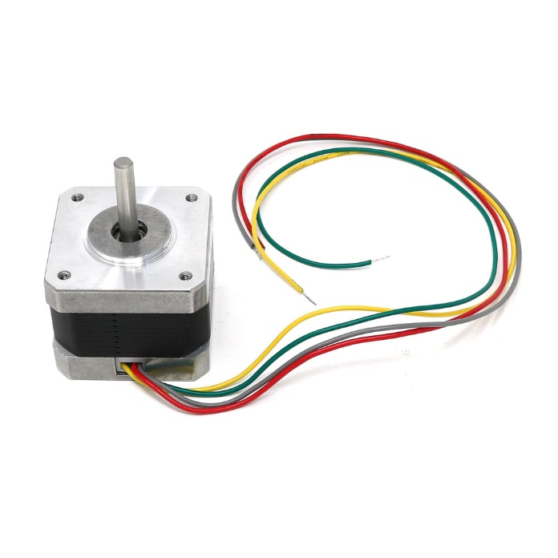
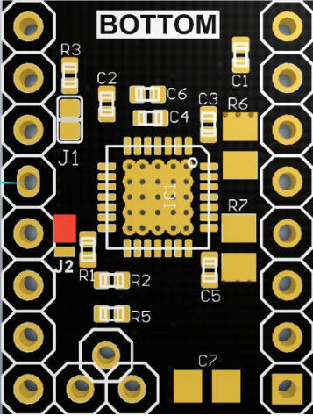

Calculating V_{ref}
$$V_{ref}=I_{max}∗8∗R_{s}$$
Where, $I_{max}$ is the current limit of the stepper motor, $R_{s}$ is the resistance of the current sensing resistor.
Motor Specification:
$I_{max}$ = 350 mA
$R_{s}$ = 0.1 $Ω$
$$V_{ref}=\left(0.350∗0.8\right)∗8∗0.1=0.22 V$$
Notes:
The motor driver uses Vref to set the maximum amount of current that can flow through the motor coils. This needs to be calculate so not to damage the motor due to excessive current. For our case, Rs is the resistance of the R5 resistor on the driver board. From the motor specification we can get a Vref value of of 0.22 V. Also, to reduce heating in the motor, we’re operating it at 80% of its current limit.

Slide 11
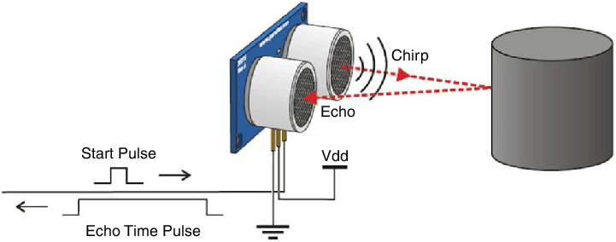

Protecting the Raspberry Pi
General Purpose Input/Output (GPIO) pins on the Raspberry Pi operate at 3.3 V.
Operating voltage of the ultrasonic sensor (HC-SR04) is 5 V.
Thus, ultrasonic sensor input to Raspberry Pi must be lowered
$$V_{out}=\frac{R1}{R1+R2}∗V_{in}=\frac{330}{330+470} ∗5≈3.3 V$$
Buck converter stabilises supply voltage.
Notes:
The GPIO pins on the Pi are designed to handle a maximum of 3.3 V. Exceeding this voltage can damage the Pi. This is a problem since the ultrasonic sensor operates at 5 V so, when the sensor sends an echo signal (indicating that it has detected an object) to the pi, the voltage level of this signal will be about 5 V. So, a potential divider is used to lower the echo signal voltage.
DO NOT READ: the echo signal is a series of HIGH & LOW (3.3V or 0 V) signals, so don’t have to save integrity of wave or anything like that

Slide 12
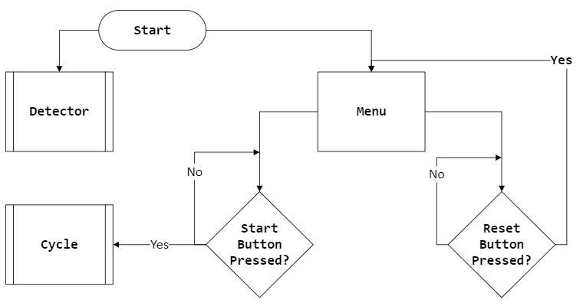
Vehicle Operation
Notes:
When the power switch is turned the the detector and a menu function starts. The menu continuously checks for button presses and starts the run/cycle if the start button is pressed, and reset the cycle if the reset is pressed. The detector starts at the same time as the menu because it takes time to boot up and vehicle doesn’t have to wait for that to happen.

Slide 13
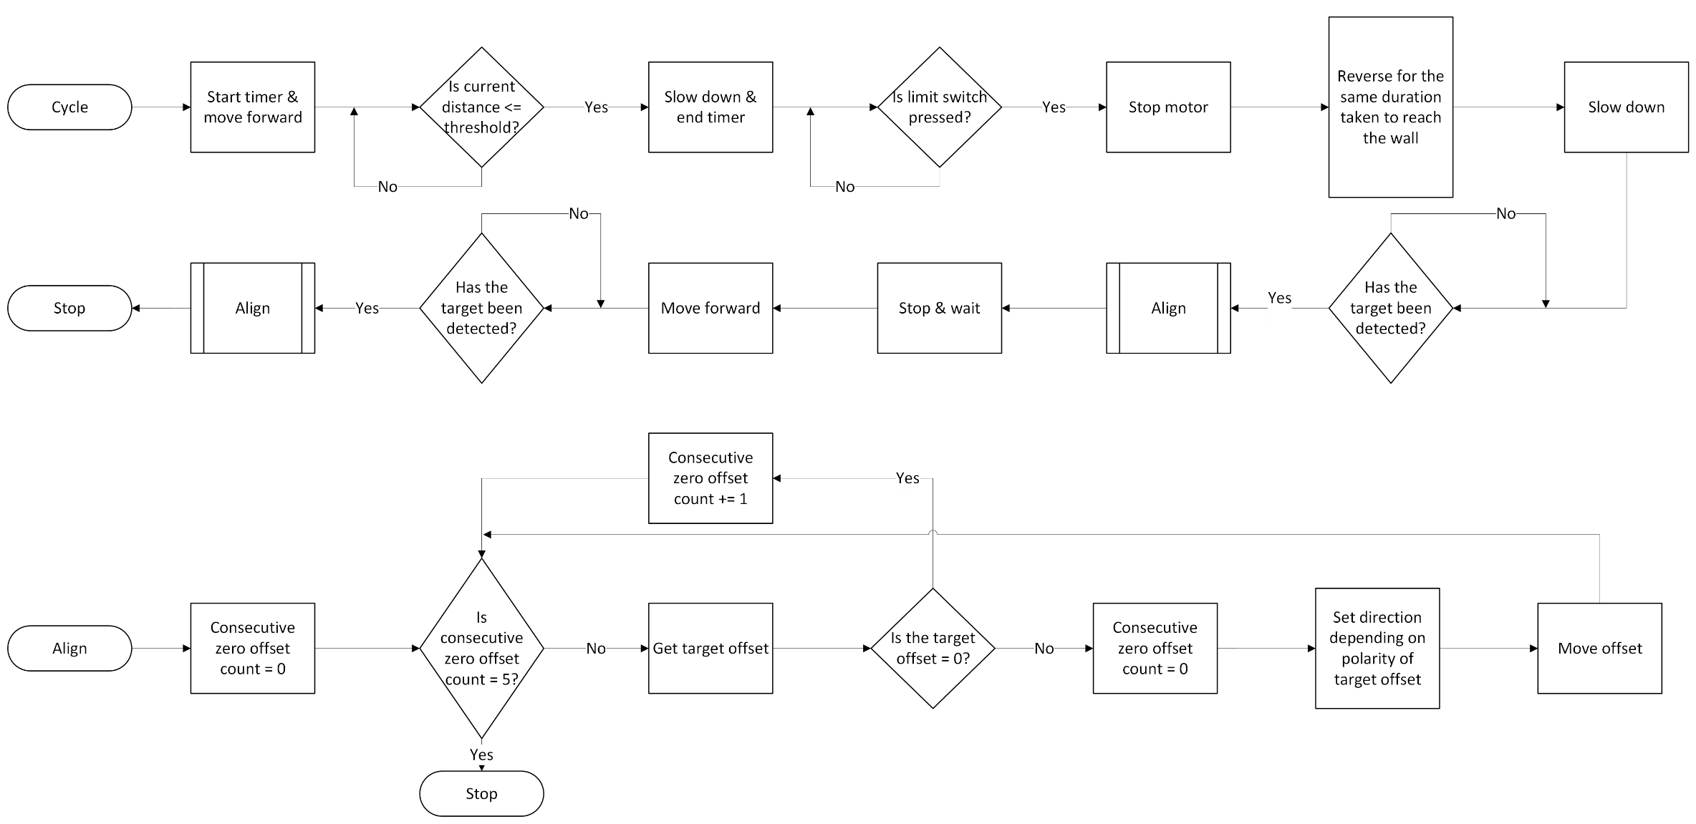
Vehicle Operation
Notes:
Once the stat button has been pressed the vehicle moves towards the wall, continuously checking if the current distance to the wall is below a threshold value. If it is below the vehicle slows down and continues until the limit switch is pressed. Once this has been pressed the vehicle stops are reverse to the target and aligns itself. Once aligned, it waits and moves forward to the next target and aligns for a final time. The alignment process is very simple it moves motor by the offset given by the camera and does this until 5 offset readings return as 0 – meaning aligned.
Once the start button has been pressed the device begins to move forward & starts a timer. It continues to move forward until, the distance to the wall is less than a threshold value. Once at the threshold the device slows down, the timer is stopped and continues to move forward until the limit switch has been pressed. The motor stops & then reverses for the measured duration of time. After this time the device slows down and searches for the target. Once found it aligns itself & waits then moves forward to the second target and aligns again. The alignment process is very simple it moves the motor by offset given by the camera and does this until 5 offset readings return as 0 – meaning aligned.

Slide 14
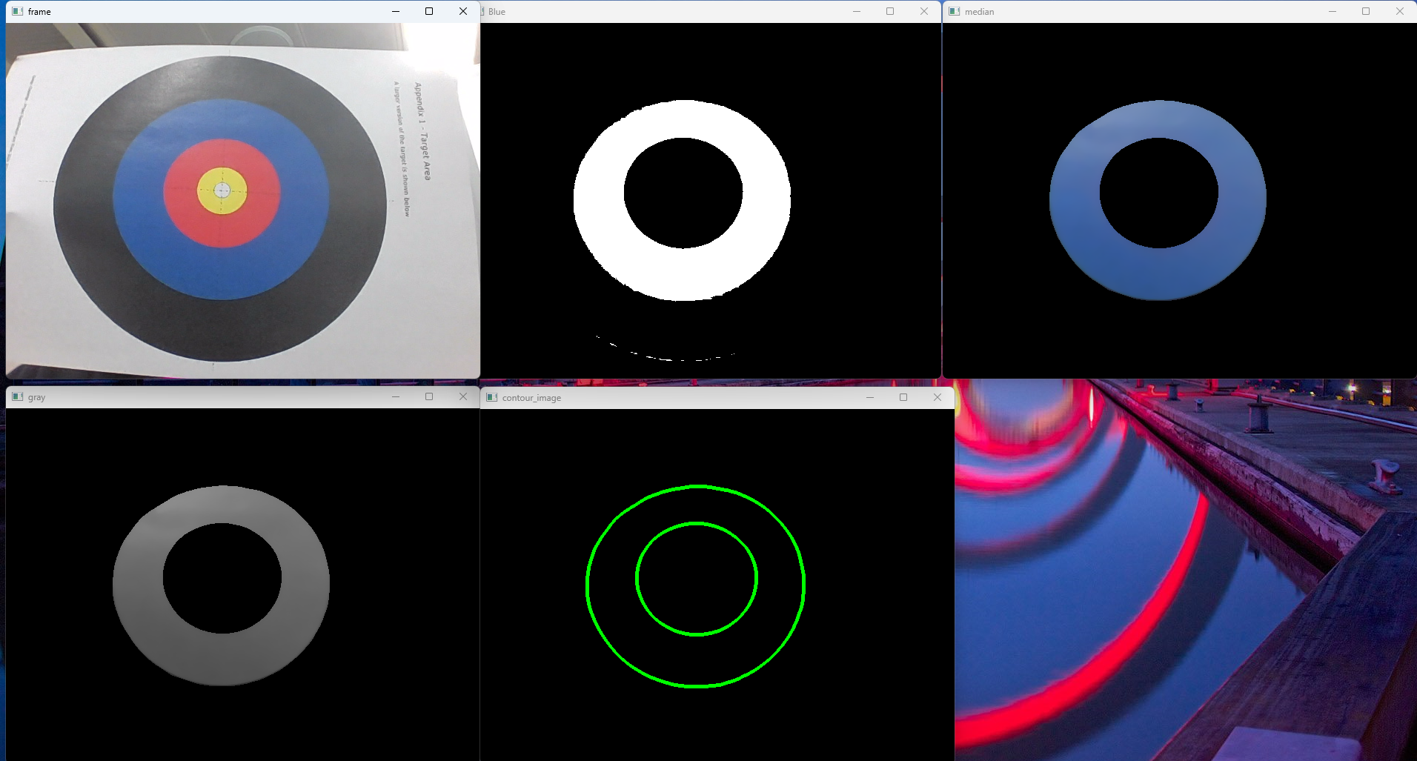
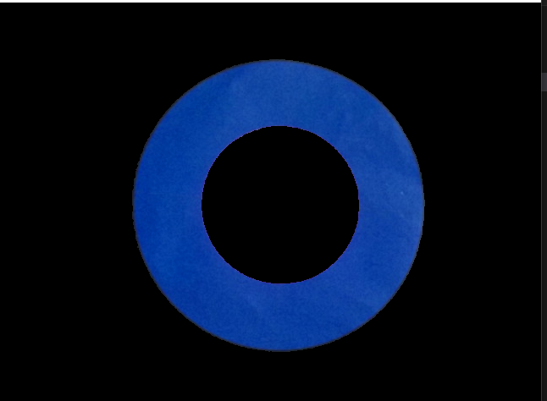
Detector – Computer Vision
Raw Input Video
Colour Segmentation
Mask Applied to Video
Notes:
The input video feed is used to detect and isolate blue ring which can then be used to calculate the offset of its centre from the centre of the video.
To isolate the blue ring, a threshold is applied to select only the specified blue hues in the video. The white region represent where blue is detected.
This can then be used as a mask to get only the blue part of the input video.

Slide 15
Detector – Computer Vision
Denoising
Greyscale Conversion
Contour Detection
Notes:
The produces a very noisy result which can affect the offset calculations. So, a median filter is applied to remove any noise.
Then converting the video to greyscale allows for easier and more accurate contour detection.
Finally, the contours are detected and are used to find the offset of the target from the centre of the video.

Slide 16
Bill of Materials

Slide 17
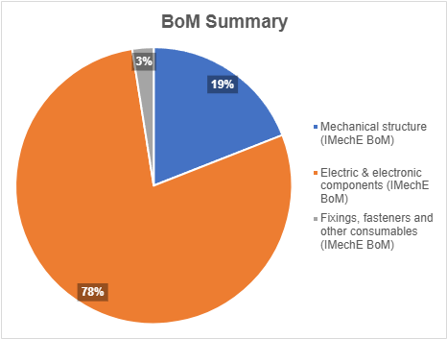
Overview
Budget
£80 excl. items less than 20p
Total
£79.25 excl. items less than 20p
£82.96 incl. items more than 20p
Remaining
£0.75 from iMechE BoM
Notes:
Note: do not simply just read off of the notes. Just say “here is the Bill of Materials overview” and state that we were under budget!
Pie chart shows for the iMechE BOM
Analyse from pie chart:
Focus on computer vision meant that more expenditure went towards electrical side
Mechanical components were quite cheap due to in-house facilities and smart usage of 3D printing and laser cutting
BOM shows well managed funding

Slide 18
Thank you!

